Slide 1
San Diego 311 Request Response Time Prediction
By Melissa Nielsen
Lighthouse Labs Final Project
January 19, 2023

Slide 2
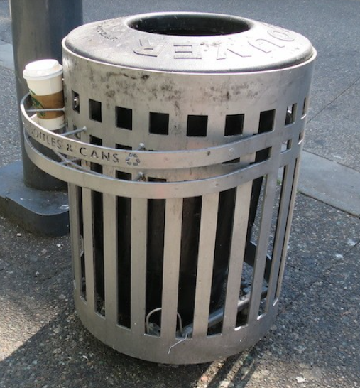

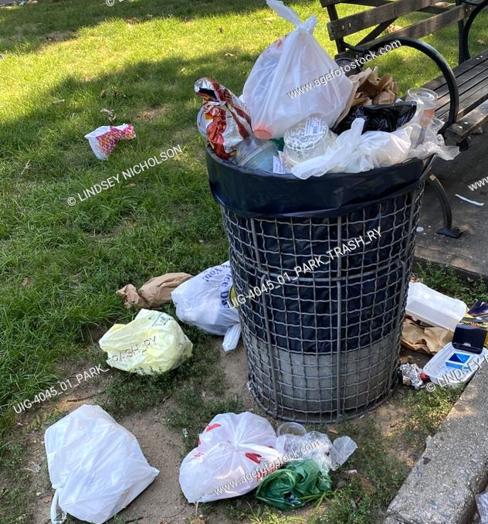
BACKGROUND
Environmental Engineer
Specialized in Waste and Recycling Systems and Data
Worked at City of Vancouver
I chose where the garbage cans go!
Looked at 311 requests to decide

Slide 3
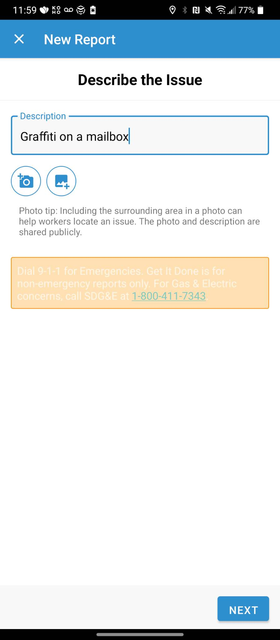
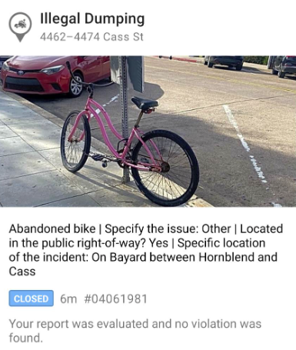
What are 311 Requests?
City request system for city-provided services
Most cities in North America
E.g. potholes, litter, missed garbage collection
You can call 311 or make request via web or mobile app
Request Input Page
Recently Closed Request
311 Requests need to be closed and the caller notified.

Slide 4

PROJECT OBJECTIVE
Create a web application that will allow members of the public to see the predicted response time for their 311 request.
Used data from San Diego’s Get It Done program.

Slide 5
PROJECT VISION
User Inputs Request in Natural Language
Black Box of Data Science Magic
Model Outputs Response Time

Slide 6
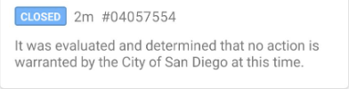
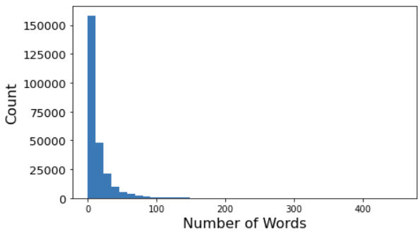
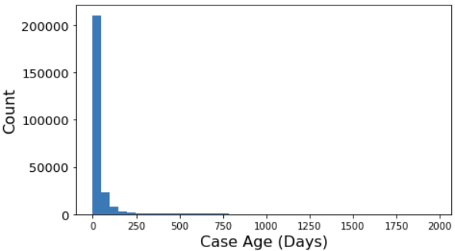
INPUT:
TEXT DESCRIPTION
OUTPUT:
RESPONSE TIME
Example
Example
Text descriptions varied from 0 words to 460 words descriptions
Response times varied from 0 days to 1,960 days
Used Standard Scaling to Account for Right Skew

Slide 7
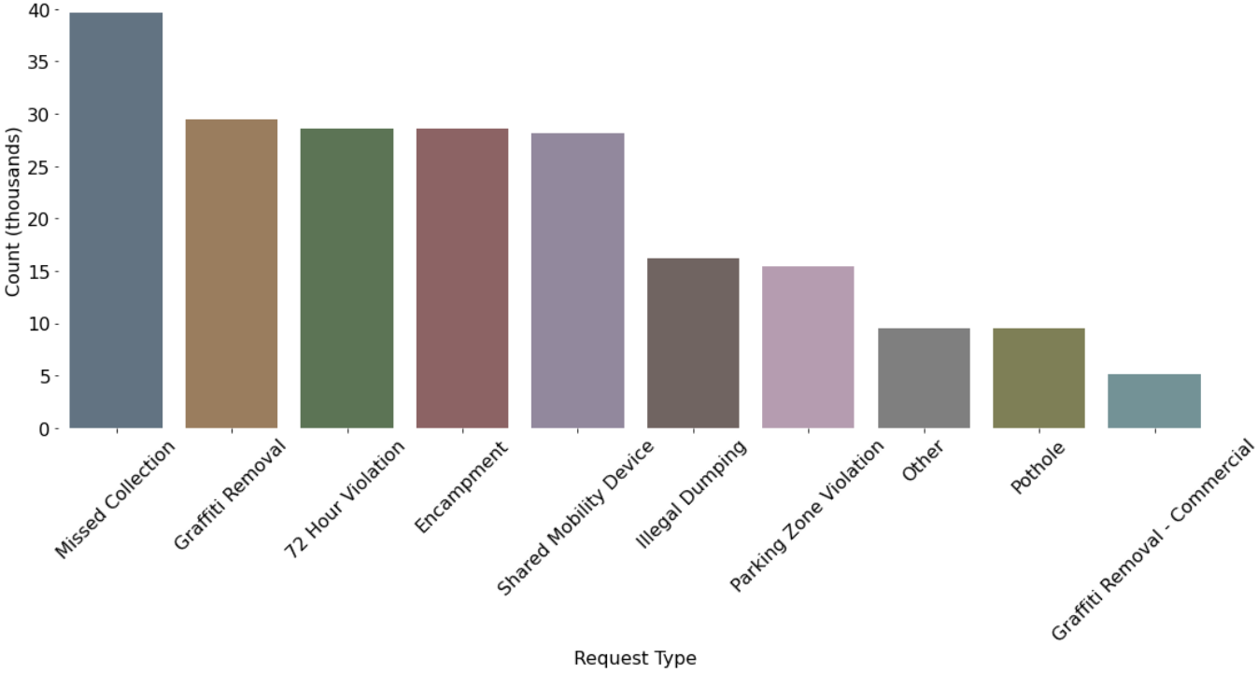


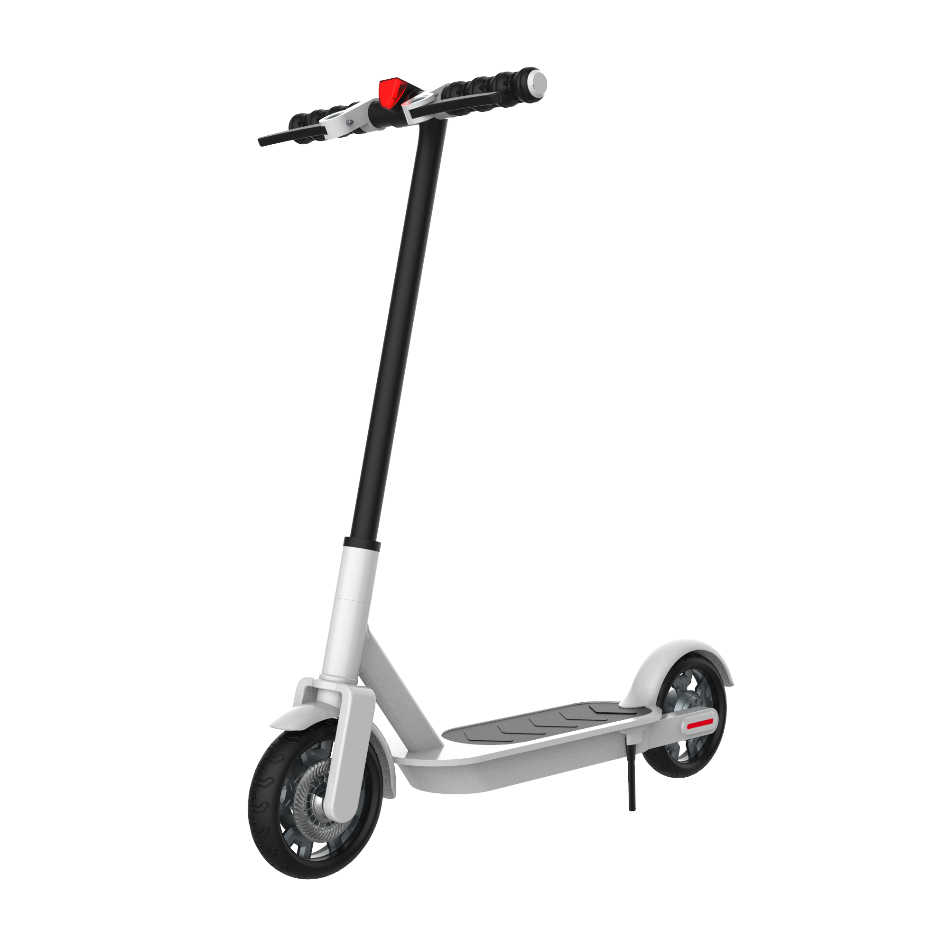


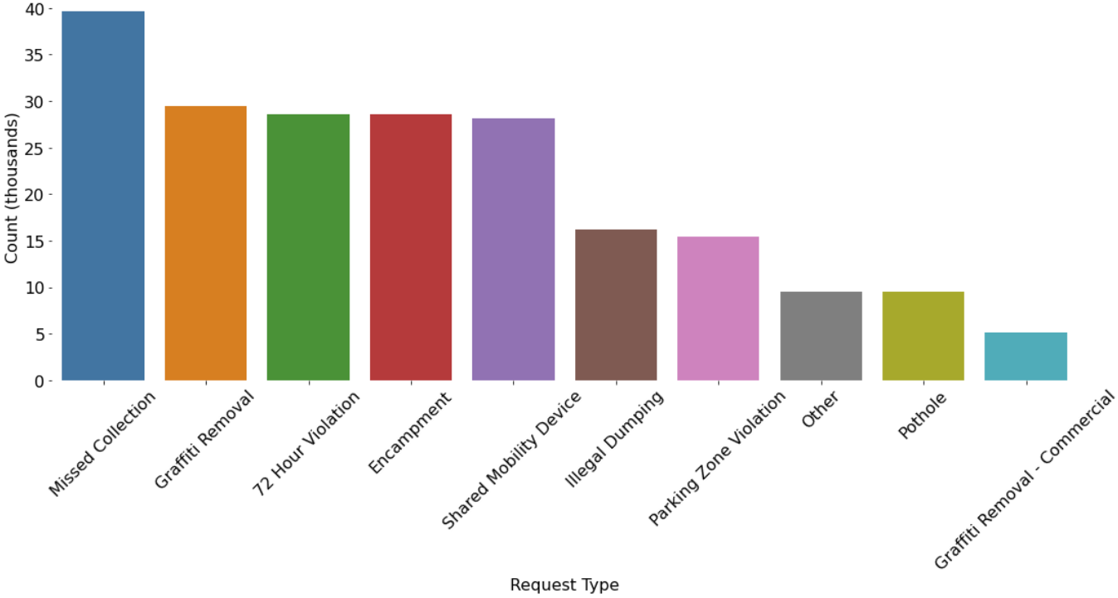
DATA OVERVIEW
TOP 5 REQUESTS
~ 250K public requests per year
Count (thousands)

Slide 8
PROJECT FLOW
User Inputs Text Data (Natural Language)
Tensorflow Model Predicts Classification (51 categories)
User is Given Opportunity to Correct Classification and Add Additional Parameters (Optional)
XGBoost Model Predicts Response Time

Slide 9
WEB APP WALKTHROUGH

Slide 10
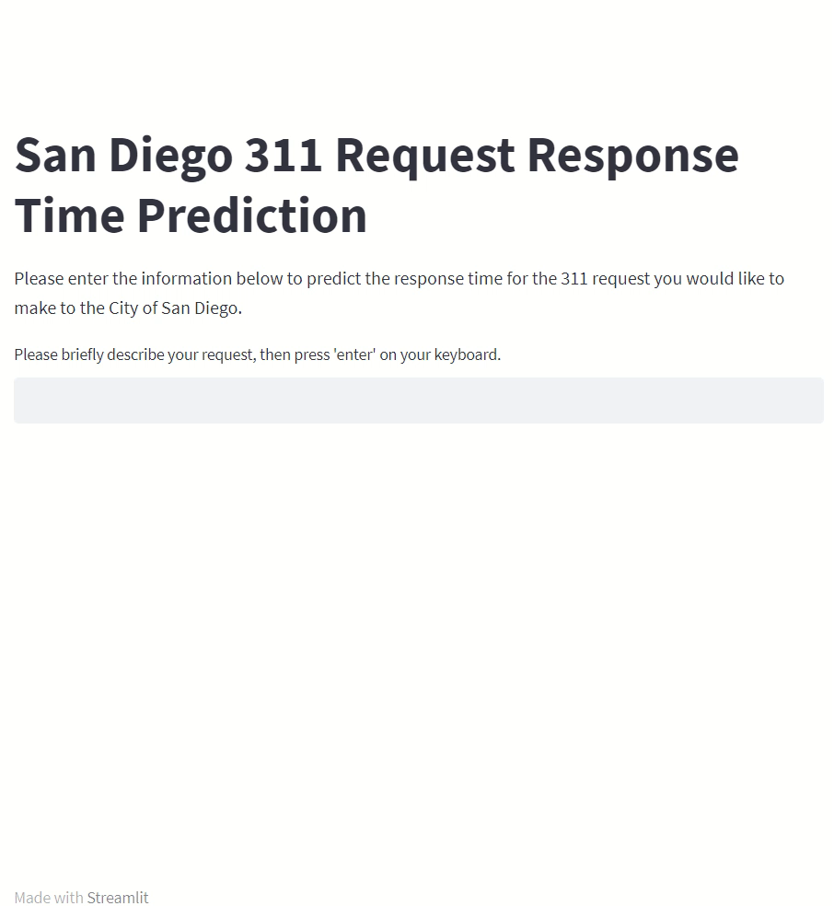

Slide 11
TYPES OF NLP USED
raw text data
cleaned, lemmatized, & tokenized text data
Embedding layer trained on English Google News corpus
Word Count
Word2Vec
Tensorflow Model
XGBoost Model

Slide 12
MODEL DETAILS
TENSORFLOW
XGBOOST
Multi-Class Classifier with 51 Classes
used class weighting to compensate for imbalanced classes.
Test accuracy of 64%!
XGB Regressor
R² of 0.48
Parameter | Accuracy (Weighted Avg)
Precision | 0.73
Recall | 0.6
F1-score | 0.63

Slide 13
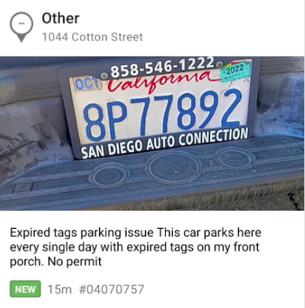
CHALLENGES
‘Case closed’ doesn’t necessarily mean ‘case fixed’. It might mean the data was referred to another department or that City staff decided not to address it.
Data labels are only as good as the app users, and the app users weren’t very good at labeling their requests correctly!
actually a PARKING issue!

Slide 14
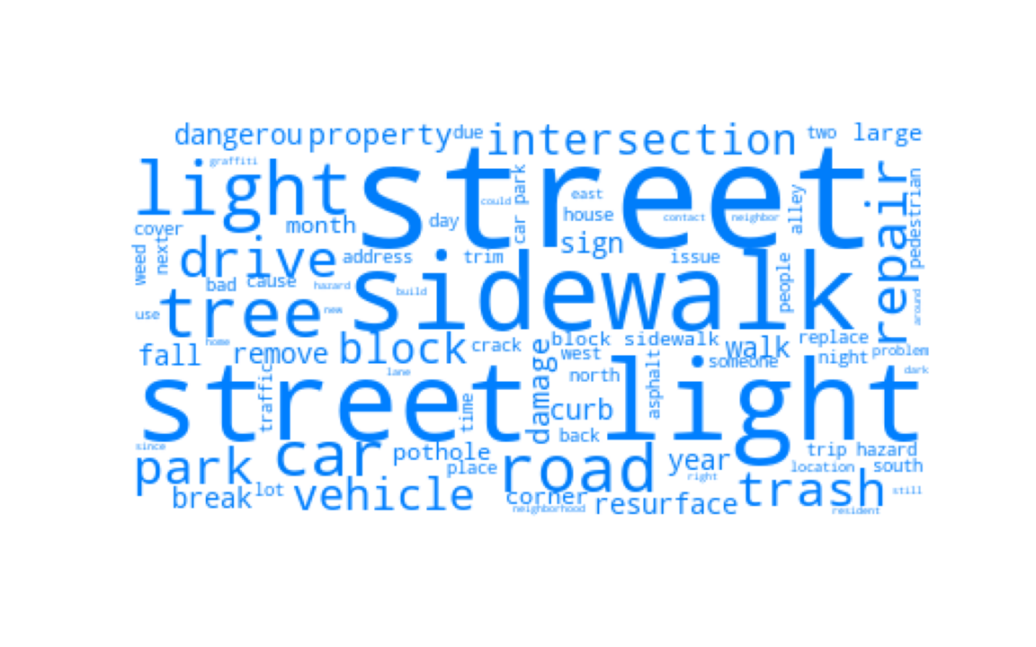
clean
the
damn
streets
please!
THANK YOU!
Melissa Nielsen
m.nic.nielsen@gmail.com
https://www.linkedin.com/in/mnicnielsen/
https://github.com/mnicnielsen

Slide 16
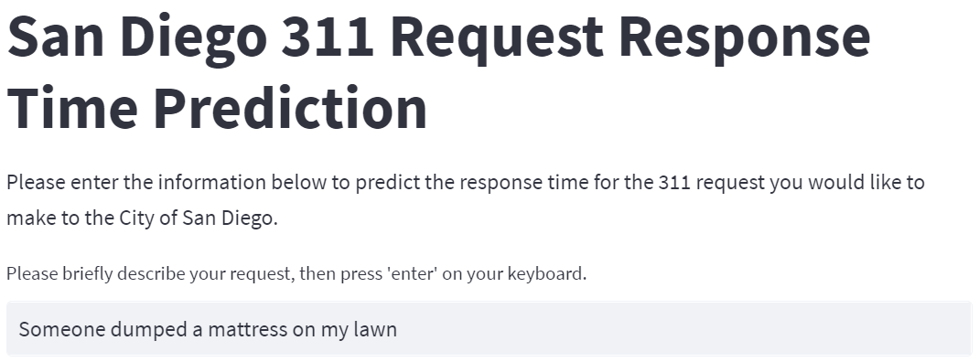
USER INPUT
Users input their request in natural language.

Slide 17
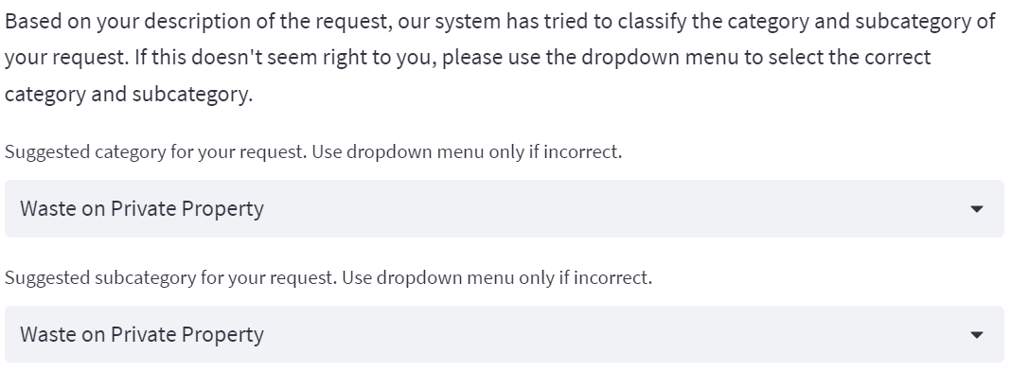
NLP PROCESSING BY TENSORFLOW MODEL
Predicted categories. User can modify if they wish.

Slide 18
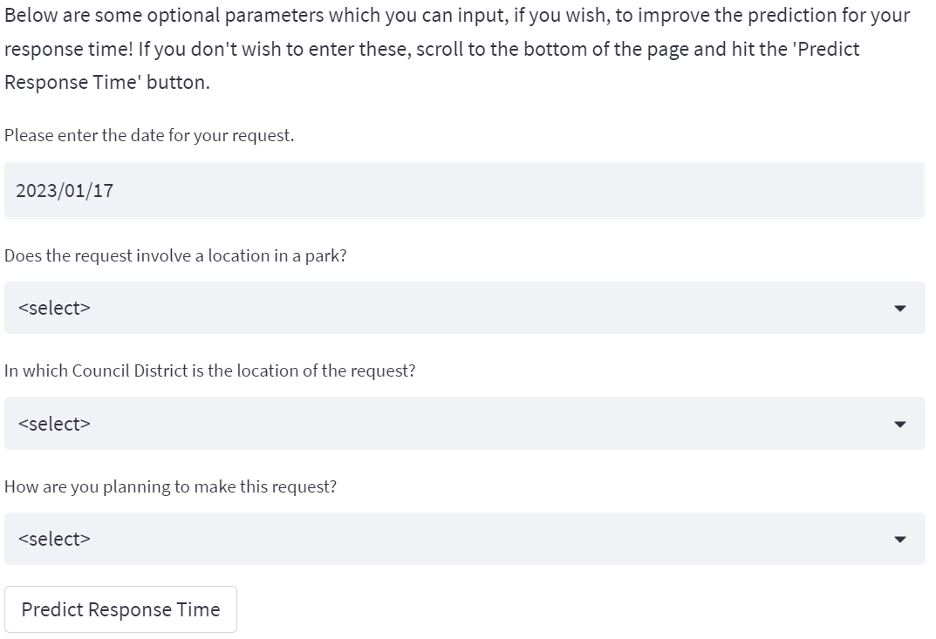
USER MAY INPUT OPTIONAL PARAMETERS
Optional Parameters

Slide 19
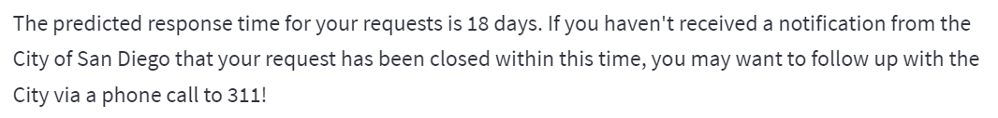
USER MAY INPUT OPTIONAL PARAMETERS
XGBoost Model predicts the response time for the request.

